Slide 1
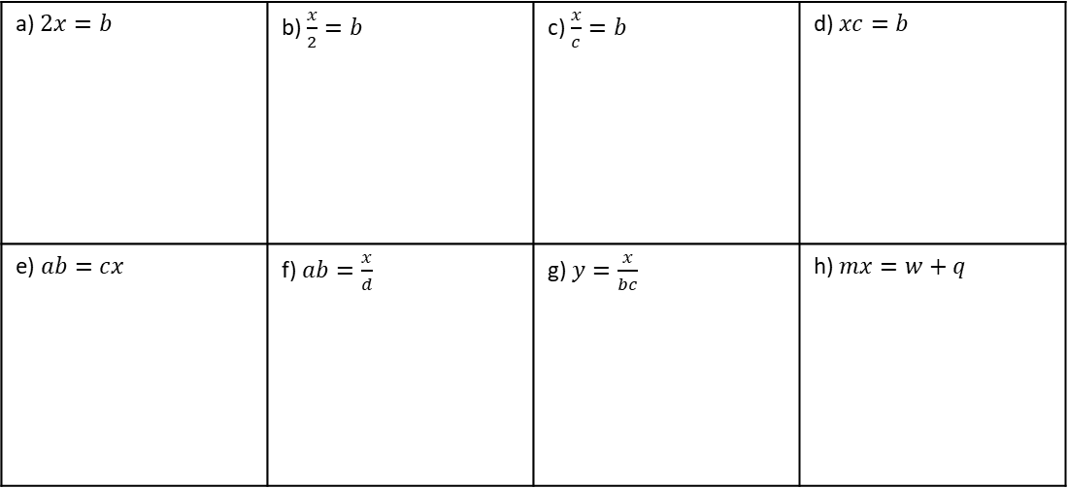
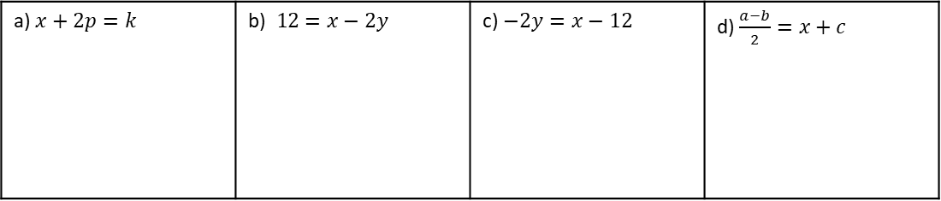
Subtopic 1 – Rearranging Formulae/ Changing the Subject
LEARNING OUTCOME: To be fluent when rearranging formulae/ changing the subject
Objectives:
Keywords:
Equation
Subject
Inverse
Formulae
To be able to rearrange formulae with one-step
To be able to rearrange formulae with two-steps
To be able to rearrange formulae requiring many-steps
Introduction/Recap
Rearranging formulae is a lot like solving equations—you still use inverse operations on both sides to
keep things balanced. The difference is, instead of finding a number, you're working to make a
specific variable (called the subject) stand alone. Making a variable the subject means rewriting the
equation so that it’s isolated on one side, usually the left. This lets you express that variable in terms
of the others. This is sometimes called changing the subject.
Prior Knowledge Quiz – One Step Rearranging
There are many types of ‘rearranging’ and ‘changing the subject’ questions – they can be simple or get very challenging. The Quiz on the pages below should be attempted individually, and your teacher will assess how much recapping is needed before you move on to more advanced algebra topics. The later topics generally rely on you being able to rearrange formulae fluently.
Question 1. Make $x$ the subject of the following:
a) $x+2p=k$ | b)$12=x−2y12=x−2y$ | c) $−2y=x−12$ | d) $\frac{a−b}{2}=x+c$
Question 2. Make $x$ the subject of the following:
a) $2x=b$ | b) $\frac{x}{2}=b$ | c) $\frac{x}{c}=b$ | d) $xc=b$
e) $ab=cx$ | f) $ab=\frac{x}{d}$ | g) $y=\frac{x}{bc}$ | h) $mx=w+q$

Slide 2
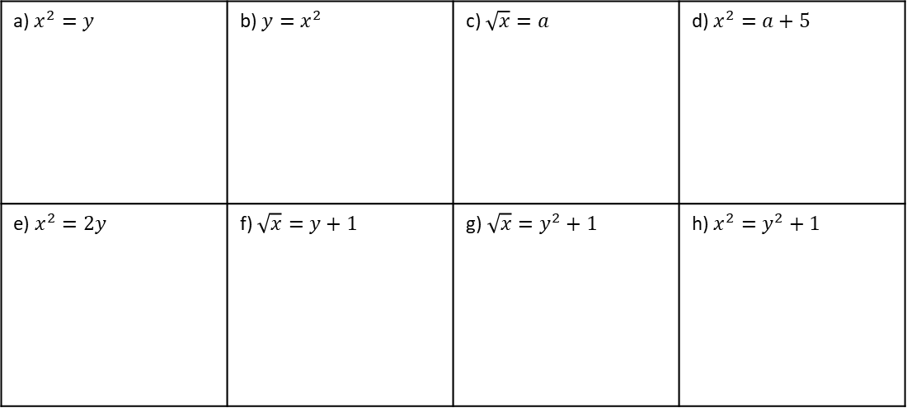
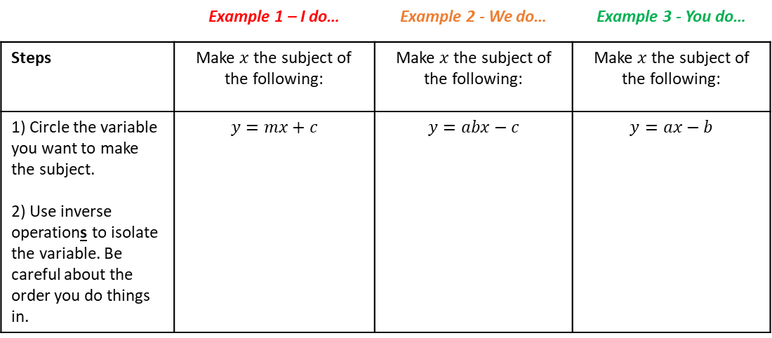
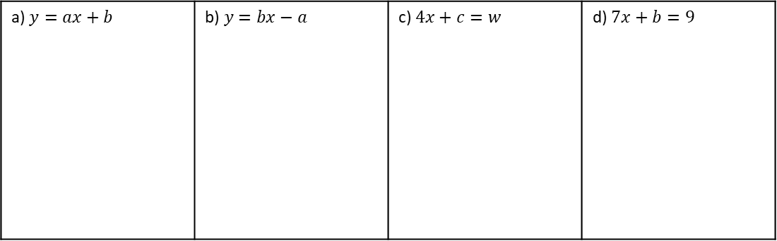
Question 3. Make $x$ the subject of the following:
a) $x^{2}=y$ | b) $y=x^{2}$ | c) $\sqrt{x}=a$ | d) $x^{2}=a+5$
e) $x^{2}=2y$ | f) $\sqrt{x}=y+1$ | g)$\sqrt{x}=y^{2}+1$ | h) $x^{2}=y^{2}+1$
Two step rearranging (addition/ subtraction with division)
 | Example 1 – I do… | Example 2 - We do… | Example 3 - You do…
Steps | Make $x$ the subject of the following: | Make $x$ the subject of the following: | Make $x$ the subject of the following:
1) Circle the variable you want to make the subject. 2) Use inverse operations to isolate the variable. Be careful about the order you do things in. | $$y=mx+c$$ | $$y=abx−c$$ | $$y=ax−b$$
Independent Practice
Question 1. Make $x$ the subject of the following:
a) $y=ax+b$ | b)$y=bx−a$ | c) $4x+c=w$ | d) $7x+b=9$

Slide 3
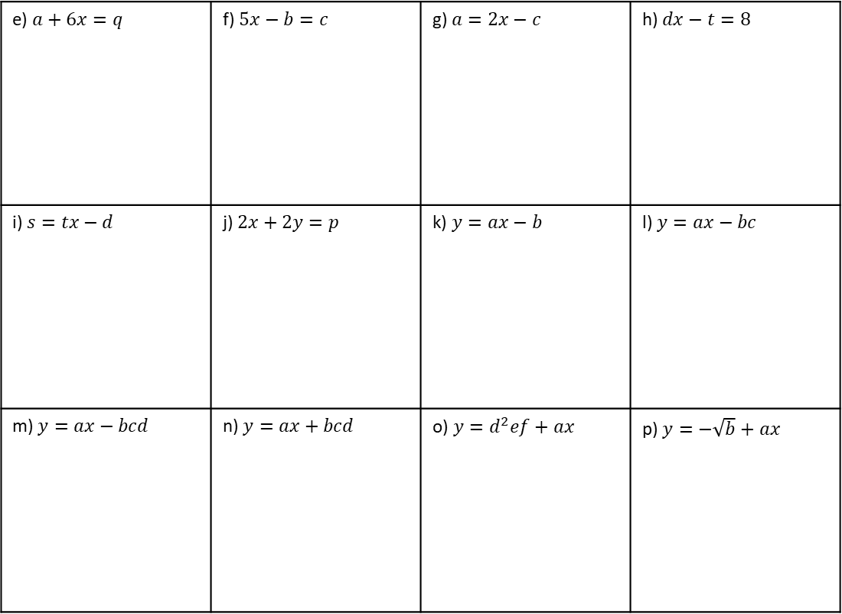
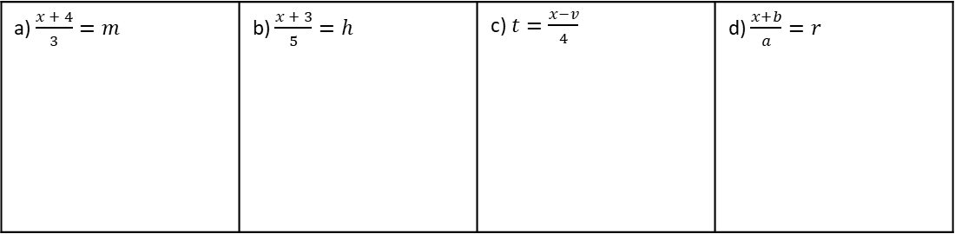
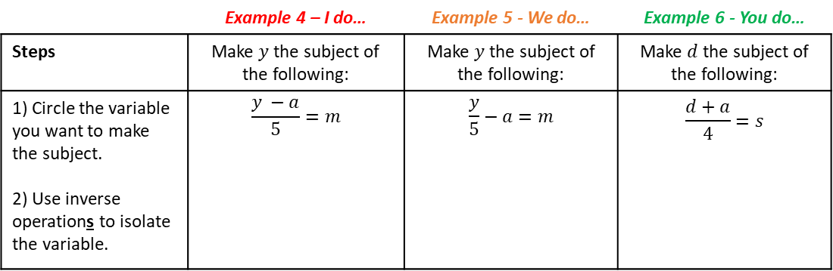
e) $a+6x=q$ | f) $5x−b=c$ | g) $a=2x−c$ | h) $dx−t=8$
i) $s=tx−d$ | j) $2x+2y=p$ | k) $y=ax−b$ | l) $y=ax−bc$
m) $y=ax−bcd$ | n) $y=ax+bcd$ | o) $y=d^{2}ef+ax$ | p) $y=−\sqrt{b}+ax$
Two step rearranging (addition/ subtraction with multiplication)
 | Example 4 – I do… | Example 5 - We do… | Example 6 - You do…
Steps | Make $y$ the subject of the following: | Make $y$ the subject of the following: | Make $d$ the subject of the following:
1) Circle the variable you want to make the subject. 2) Use inverse operations to isolate the variable. | $$\frac{y −a}{5}=m$$ | $$\frac{y}{5}−a=m$$ | $$\frac{d+a}{4}=s$$
Independent Practice
Question 2. Make $x$ the subject of the following:
a) $\frac{x + 4}{3}=m$ | b) $\frac{x + 3}{5}=h$ | c) $t=\frac{x−v}{4}$ | d) $\frac{x+b}{a}=r$

Slide 4
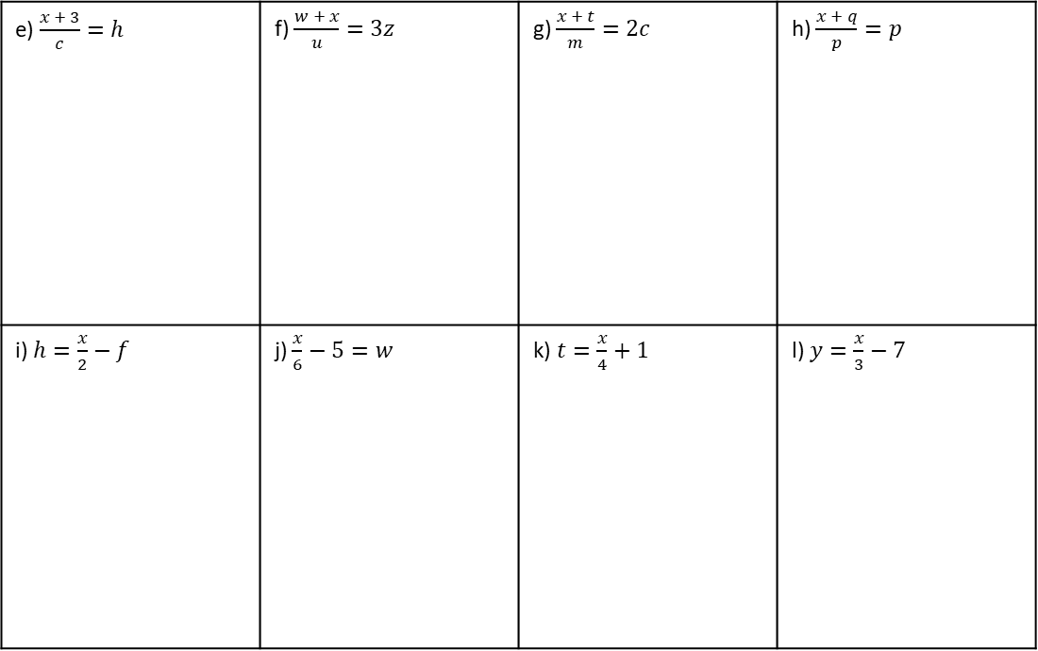
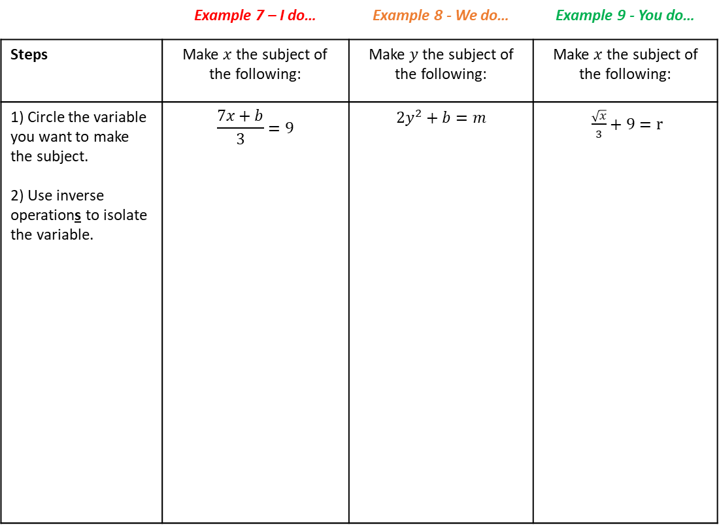
e) $\frac{x + 3}{c}=h$ | f) $\frac{w + x}{u}=3z$ | g) $\frac{x + t}{m}=2c$ | h) $\frac{x + q}{p}=p$
i) $h=\frac{x}{2}−f$ | j) $\frac{x}{6}−5=w$ | k) $t=\frac{x}{4}+1$ | l) $y=\frac{x}{3}−7$
Multi-step rearranging
 | Example 7 – I do… | Example 8 - We do… | Example 9 - You do…
Steps | Make $x$ the subject of the following: | Make $y$ the subject of the following: | Make $x$ the subject of the following:
1) Circle the variable you want to make the subject. 2) Use inverse operations to isolate the variable. | $$\frac{7x+b}{3}=9$$ | $$2y^{2}+b=m$$ | $\frac{\sqrt{x}}{3}+9=r$

Slide 5
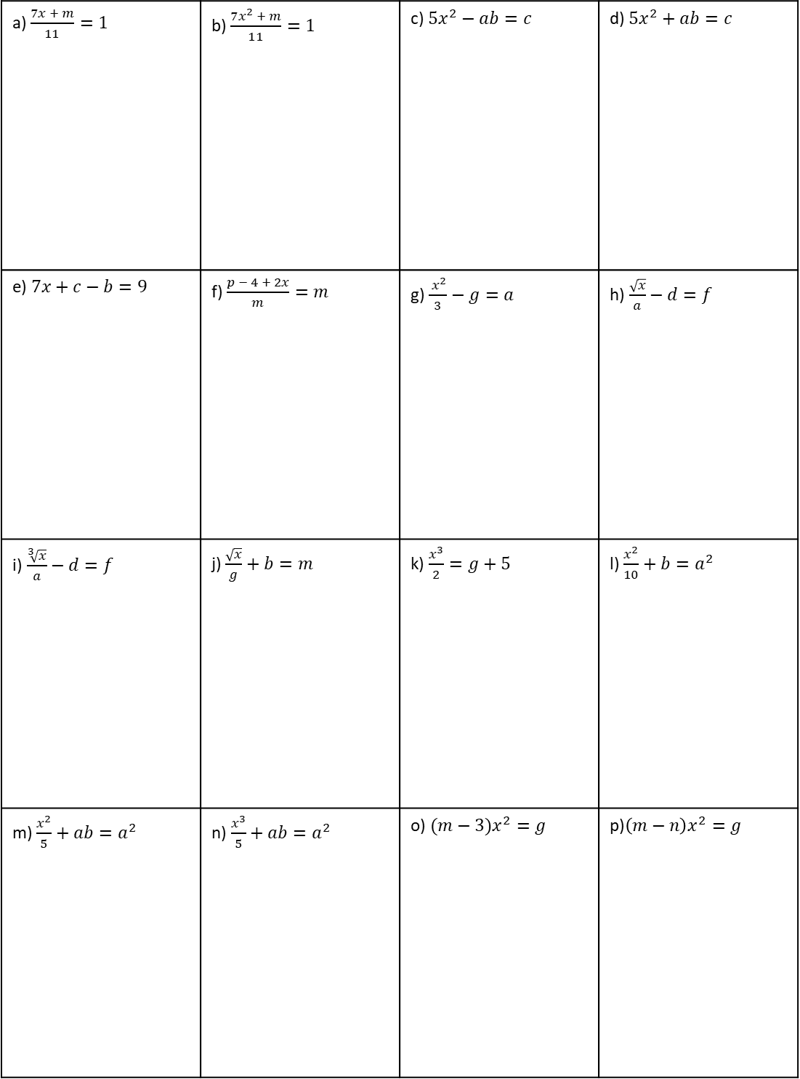
Independent Practice
Question 3. Make $x$ the subject of the following:
a) $\frac{7x + m}{11}=1$ | b) $\frac{7x^{2} + m}{11}=1$ | c) $5x^{2}−ab=c$ | d) $5x^{2}+ab=c$
e)$7x+c−b=9$ | f) $\frac{p − 4 + 2x}{m}=m$ | g) $\frac{ x^{2}}{3}−g=a$ | h)$\frac{\sqrt{x}}{a}−d=f$
i)$\frac{\sqrt[3]{x}}{a}−d=f$ | j) $\frac{\sqrt{x}}{g}+b=m$ | k) $\frac{x^{3}}{2}=g+5$ | l) $\frac{x^{2}}{10}+b=a^{2}$
m) $\frac{x^{2}}{5}+ab=a^{2}$ | n)$\frac{x^{3}}{5}+ab=a^{2}$ | o) $(m−3)x^{2}=g$ | p)$\left(m−n\right)x^{2}=g$

Slide 6
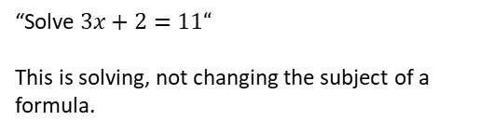
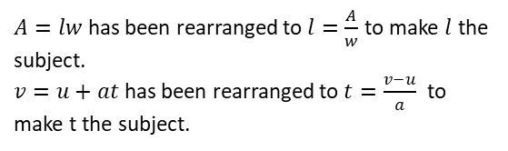
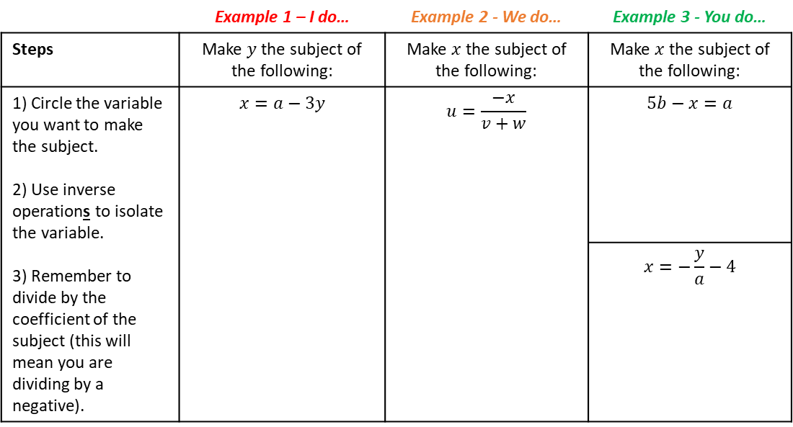
Rearranging More Complex Formulae
LEARNING OUTCOME: To be able to rearrange more complex formulae
Objectives:
Keywords:
Equation
Subject
Inverse
Formulae
To be able to rearrange equations with negative unknowns
To be able to rearrange equations with the subject in the denominator
To be able to rearrange equations where the subject appears more than once
Introduction
When rearranging more complex equations, you’ll use the same basic steps, but things can get a bit
trickier. You might have to deal with negative variables, variables in the denominator, or even the
subject appearing more than once. In these cases, you may need to multiply both sides to eliminate
fractions, move terms carefully, and sometimes factorise expressions to get the subject on its own. It
takes a few more steps, but the key is still to use inverse operations and keep both sides balanced.
Definition
Characteristics
Changing the subject of a formula means rearranging the formula to make a different variable the subject (i.e., on its own on one side of the equals sign).
Involves inverse operations (e.g., undoing addition with subtraction) and works step-by-step like solving an equation, keeping the equation balanced on both sides.
The subject is the variable you’re isolating.
Examples
Changing the subject
Non - Examples
$A=lw$ has been rearranged to $l=\frac{A}{w}$ to make $l$ the subject.
$v=u+at$ has been rearranged to $t=\frac{v−u}{a}$ to make t the subject.
“Solve $3x+2=11“$
This is solving, not changing the subject of a formula.
Rearranging with negative unknowns
 | Example 1 – I do… | Example 2 - We do… | Example 3 - You do…
Steps | Make $y$ the subject of the following: | Make $x$ the subject of the following: | Make $x$ the subject of the following:
1) Circle the variable you want to make the subject. 2) Use inverse operations to isolate the variable. 3) Remember to divide by the coefficient of the subject (this will mean you are dividing by a negative). | $$x=a−3y$$ | $$u=\frac{−x}{v+w}$$ | $$5b−x=a$$
 |  |  | $$x=−\frac{y}{a}−4$$

Slide 7
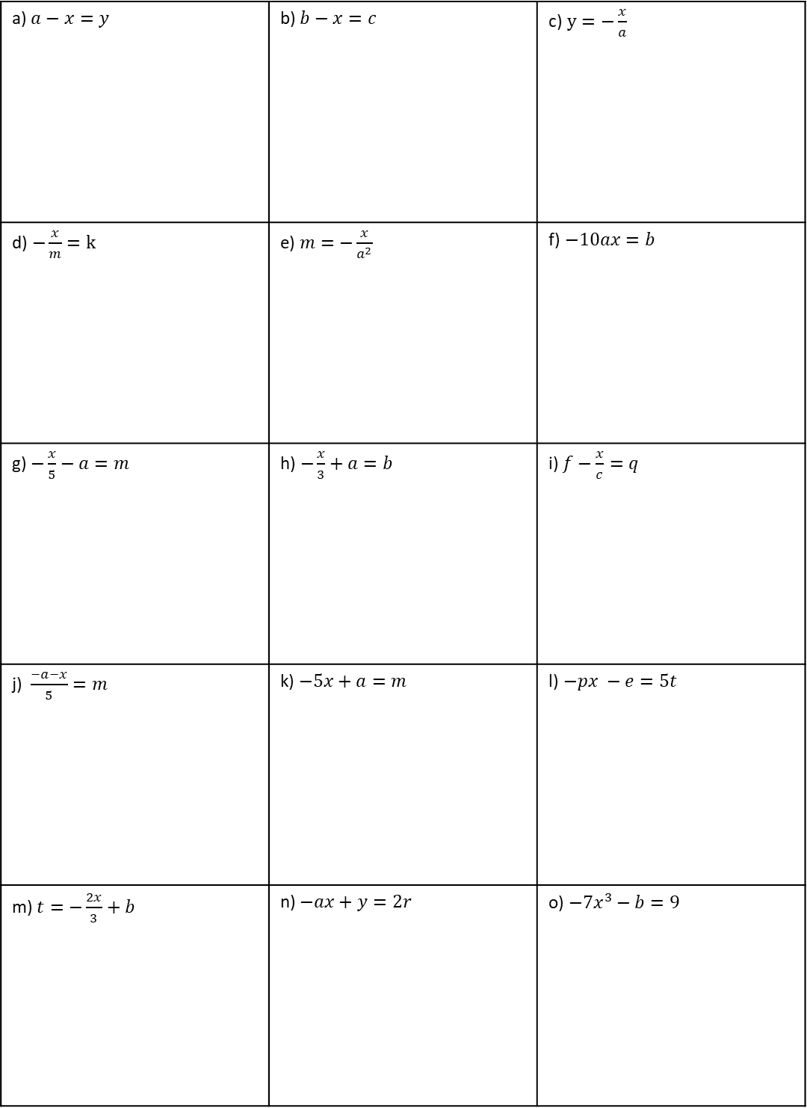
Independent Practice
Question 1. Make $x$ the subject of the following:
a) $a−x=y$ | b) $b−x=c$ | c)$y=−\frac{x}{a}$
d)$−\frac{x}{m}=k$ | e)$m=−\frac{x}{a^{2}}$ | f)$−10ax=b$
g) $−\frac{x}{5}−a=m$ | h)$−\frac{x}{3}+a=b$ | i) $f−\frac{x}{c}=q$
j)$\frac{−a−x}{5}=m$ | k) $−5x+a=m$ | l)$−px −e=5t$
m) $t=−\frac{2x}{3}+b$ | n) $−ax+y=2r$ | o) $−7x^{3}−b=9$

Slide 8
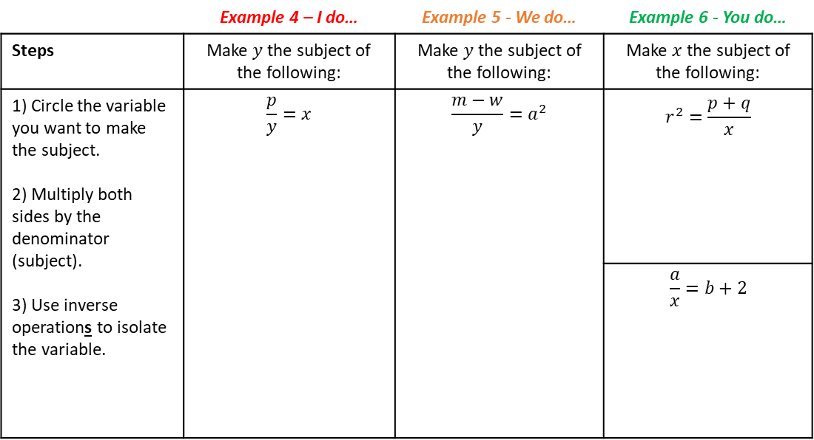
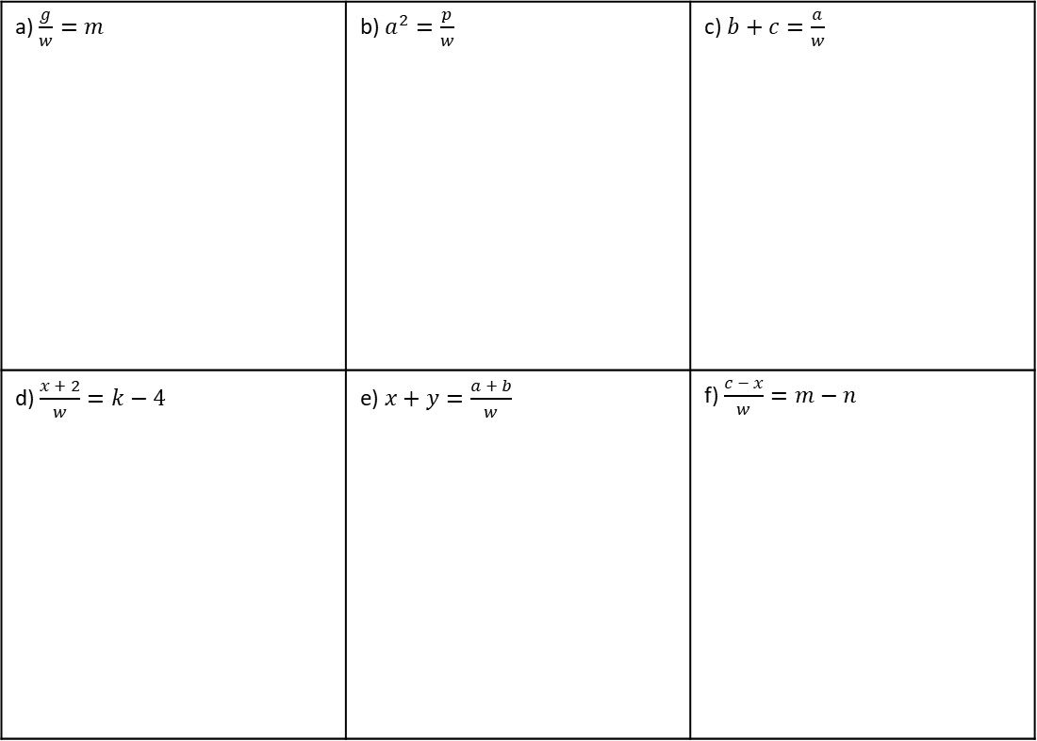
Rearranging with the subject in the denominator
 | Example 4 – I do… | Example 5 - We do… | Example 6 - You do…
Steps | Make $y$ the subject of the following: | Make $y$ the subject of the following: | Make $x$the subject of the following:
1) Circle the variable you want to make the subject. 2) Multiply both sides by the denominator (subject). 3) Use inverse operations to isolate the variable. | $$\frac{p}{y}=x$$ | $$\frac{m−w}{y}=a^{2}$$ | $$r^{2}=\frac{p+q}{x}$$
 |  |  | $$\frac{a}{x}=b+2$$
Independent Practice
Question 2. Make $w$ the subject of the following:
a) $\frac{g}{w}=m$ | b) $a^{2}=\frac{p}{w}$ | c) $b+c=\frac{a}{w}$
d) $\frac{x + 2}{w}=k−4$ | e) $x+y=\frac{a + b}{w}$ | f) $\frac{c − x}{w}=m−n$

Slide 9
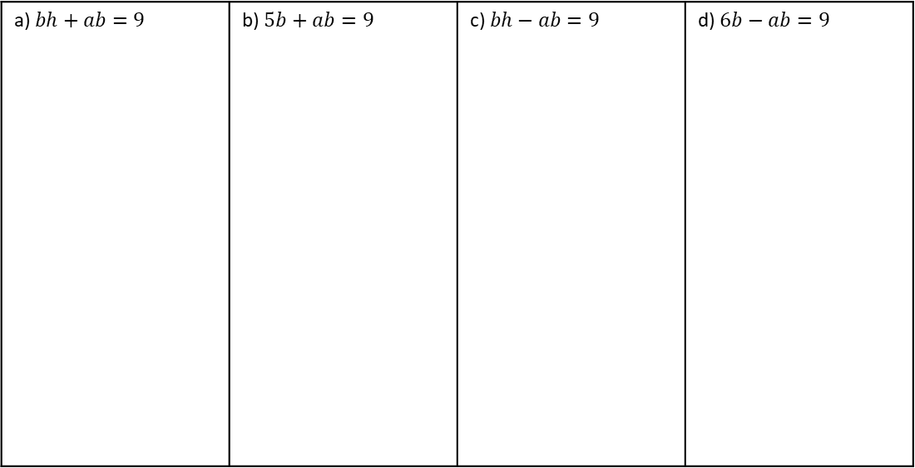
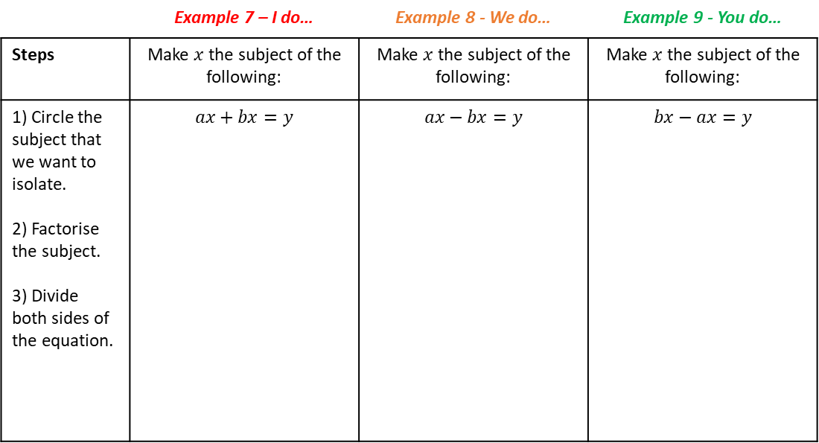
Rearranging where the subject appears twice
Introduction
Sometimes, when rearranging a formula, the variable you want to make the subject appears more
than once. In this case, you can’t isolate it right away—you first need to collect all the terms
containing that variable on one side of the formula. Then, you factorise by taking the variable out,
which means writing it once, multiplied by a bracket. This makes it possible to divide and fully isolate
the subject. It’s an extra step, but it follows the same logic: work step by step to get the subject by
itself. In this section you will practice a series of increasingly difficult question types that involve
factorising, while incorporating all of the previous rearranging knowledge you have acquired.
 | Example 7 – I do… | Example 8 - We do… | Example 9 - You do…
Steps | Make $x$ the subject of the following: | Make $x$ the subject of the following: | Make $x$ the subject of the following:
1) Circle the subject that we want to isolate. 2) Factorise the subject. 3) Divide both sides of the equation. | $$ax+bx=y$$ | $$ax−bx=y$$ | $$bx−ax=y$$
Independent Practice
Question 3. Make $b$ the subject of the following:
a) $bh+ab=9$ | b) $5b+ab=9$ | c) $bh−ab=9$ | d) $6b−ab=9$

Slide 10
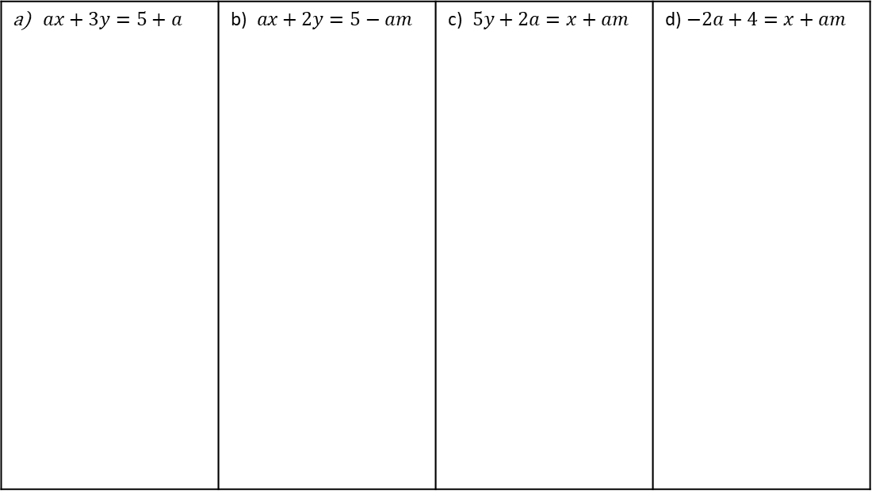
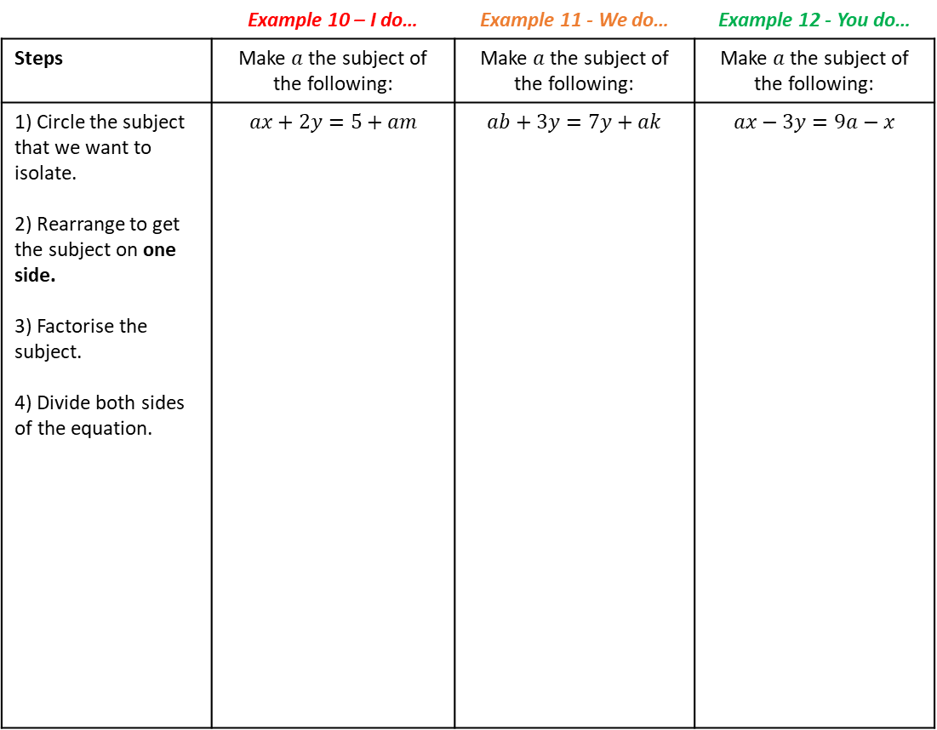
 | Example 10 – I do… | Example 11 - We do… | Example 12 - You do…
Steps | Make $a$the subject of the following: | Make $a$ the subject of the following: | Make $a$ the subject of the following:
1) Circle the subject that we want to isolate. 2) Rearrange to get the subject on one side. 3) Factorise the subject. 4) Divide both sides of the equation. | $$ax+2y=5+am$$ | $$ab+3y=7y+ak$$ | $$ax−3y=9a−x$$
Independent Practice
Question 4. Make $a$the subject of the following:
$ax+3y=5+a$ | b)$ax+2y=5−am$ | c)$5y+2a=x+am$ | d)$−2a+4=x+am$

Slide 11
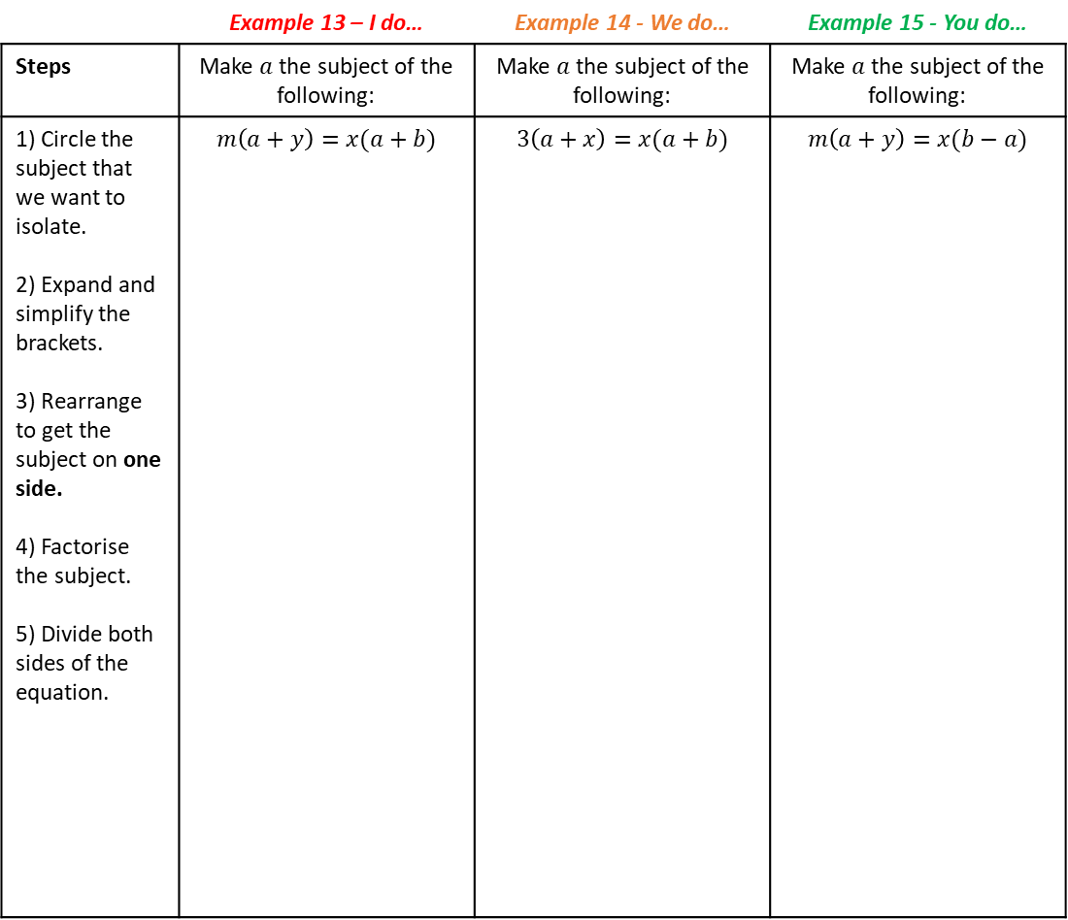
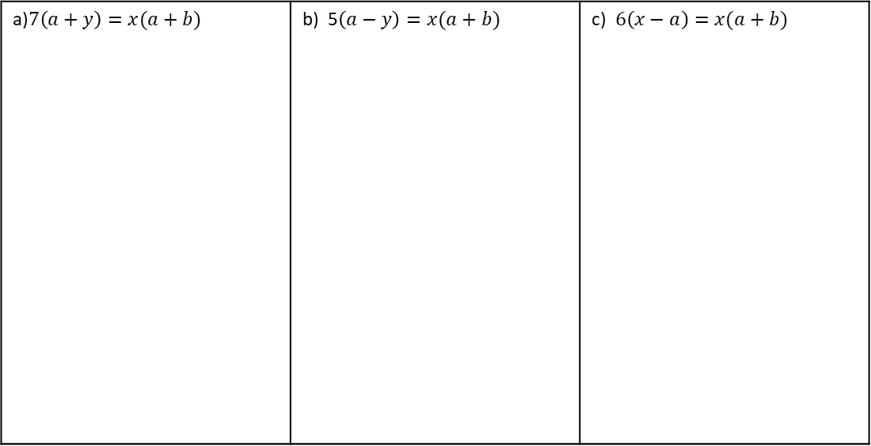
 | Example 13 – I do… | Example 14 - We do… | Example 15 - You do…
Steps | Make $a$the subject of the following: | Make $a$ the subject of the following: | Make $a$ the subject of the following:
1) Circle the subject that we want to isolate. 2) Expand and simplify the brackets. 3) Rearrange to get the subject on one side. 4) Factorise the subject. 5) Divide both sides of the equation. | $$m\left(a+y\right)=x(a+b)$$ | $$3\left(a+x\right)=x(a+b)$$ | $$m\left(a+y\right)=x(b−a)$$
Independent Practice
Question 6. Make $a$ the subject of the following:
a)$7\left(a+y\right)=x(a+b)$ | b) 5$\left(a−y\right)=x(a+b)$ | c) $6\left(x−a\right)=x(a+b)$

Slide 12
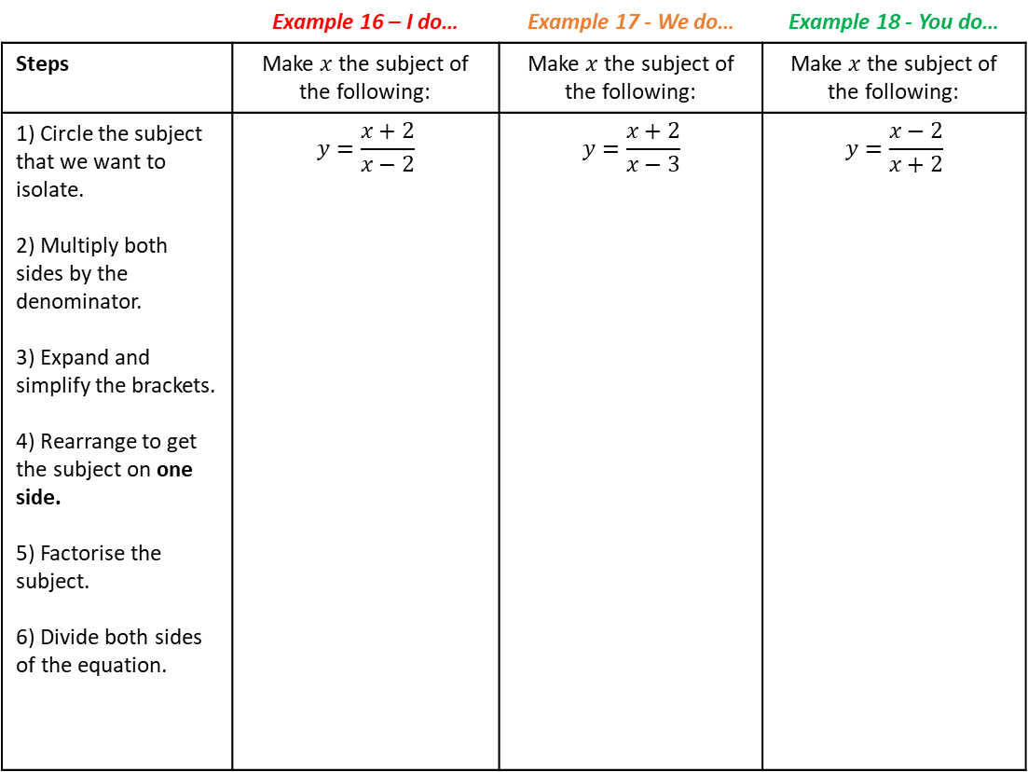
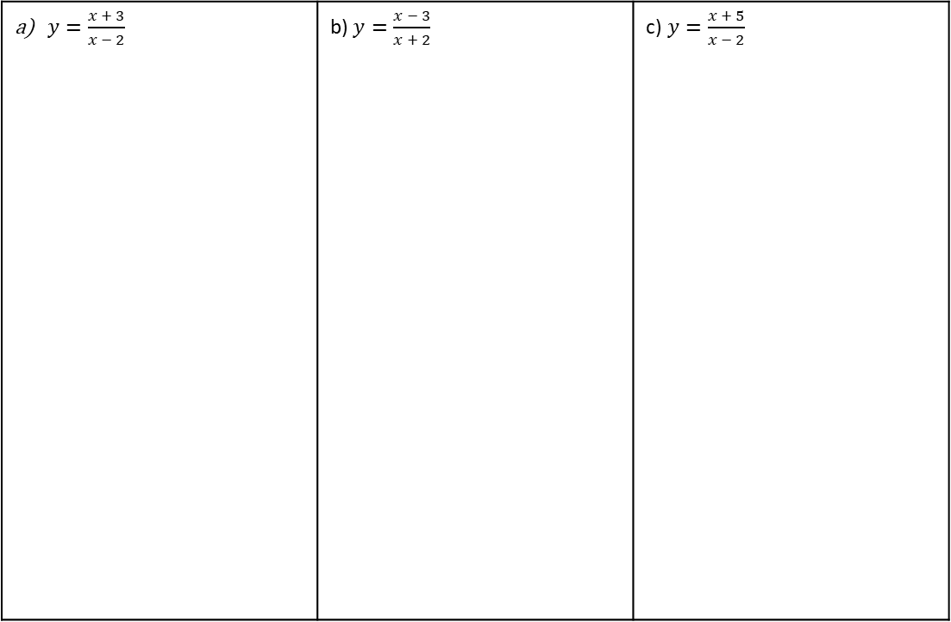
 | Example 16 – I do… | Example 17 - We do… | Example 18 - You do…
Steps | Make $x$the subject of the following: | Make $x$ the subject of the following: | Make $x$ the subject of the following:
1) Circle the subject that we want to isolate. 2) Multiply both sides by the denominator. 3) Expand and simplify the brackets. 4) Rearrange to get the subject on one side. 5) Factorise the subject. 6) Divide both sides of the equation. | $$y=\frac{x+2}{x−2}$$ | $$y=\frac{x+2}{x−3}$$ | $$y=\frac{x−2}{x+2}$$
Independent Practice
Question 7. Make $x$the subject of the following:
$y=\frac{x + 3}{x − 2}$ | b) $y=\frac{x − 3}{x + 2}$ | c)$y=\frac{x + 5}{x − 2}$

Slide 13
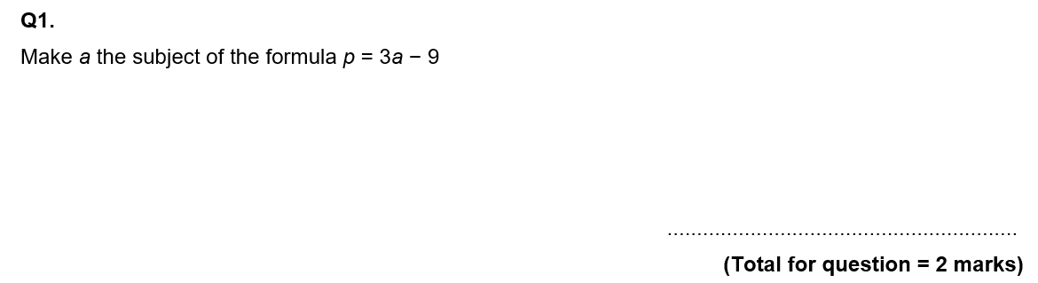
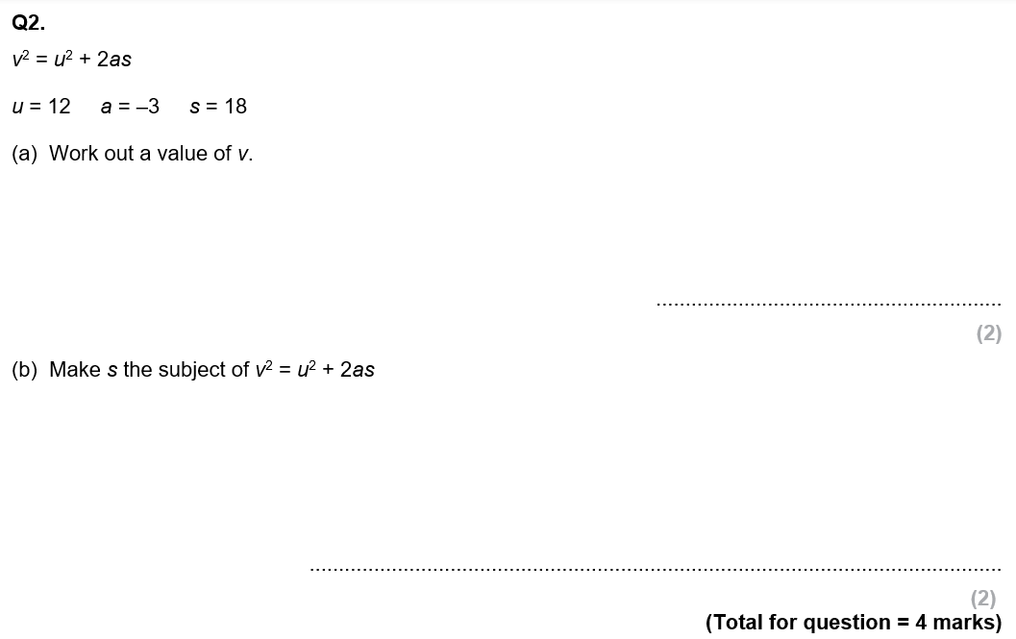
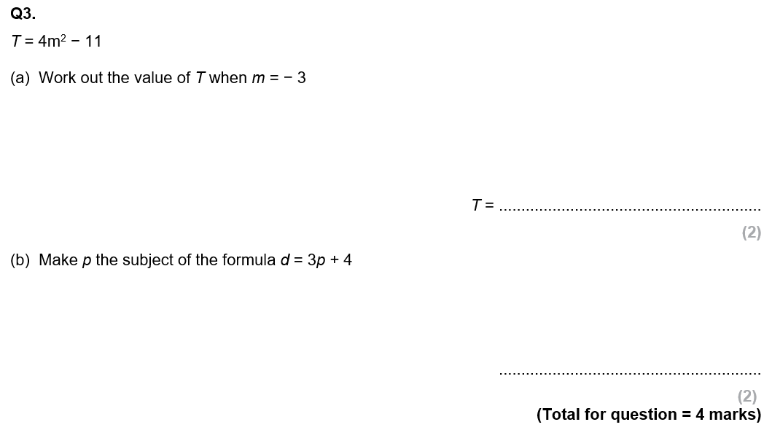
GCSE Past Paper Questions

Slide 14
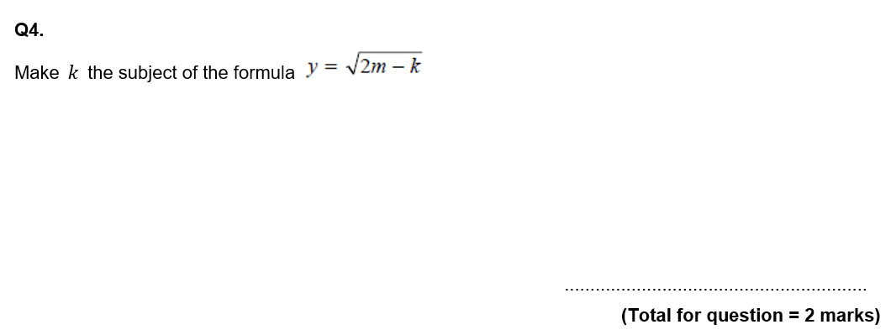
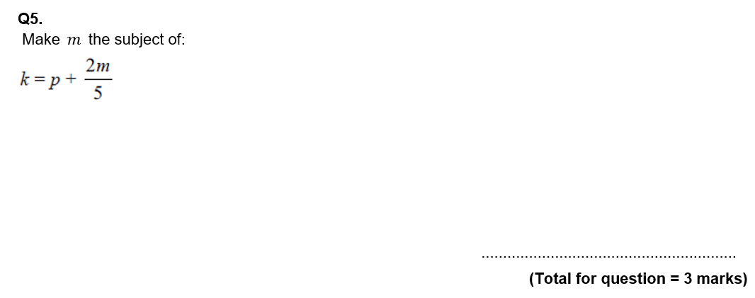
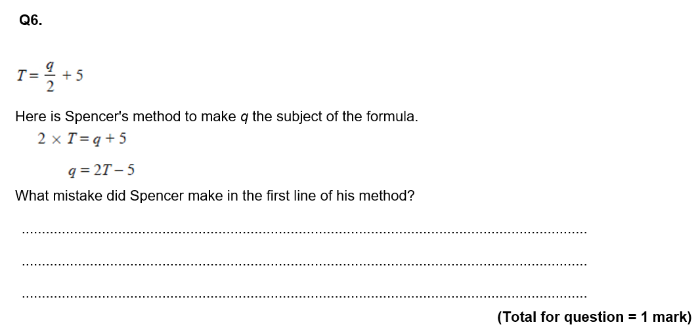

Slide 15
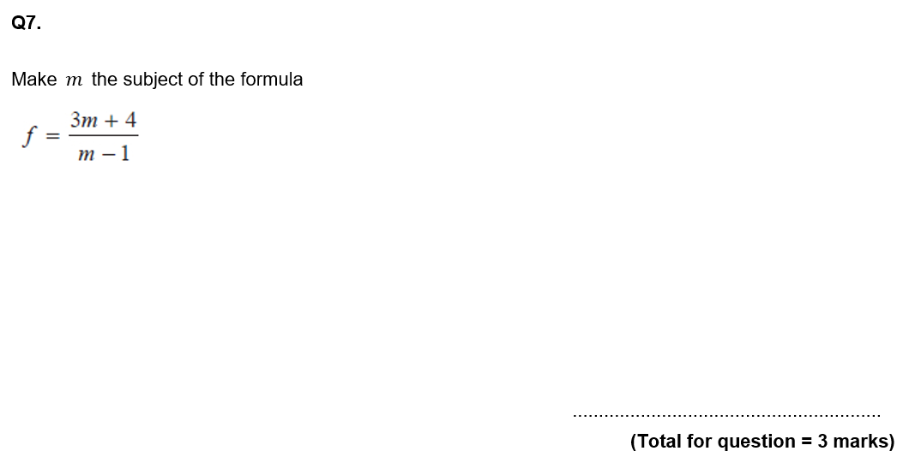
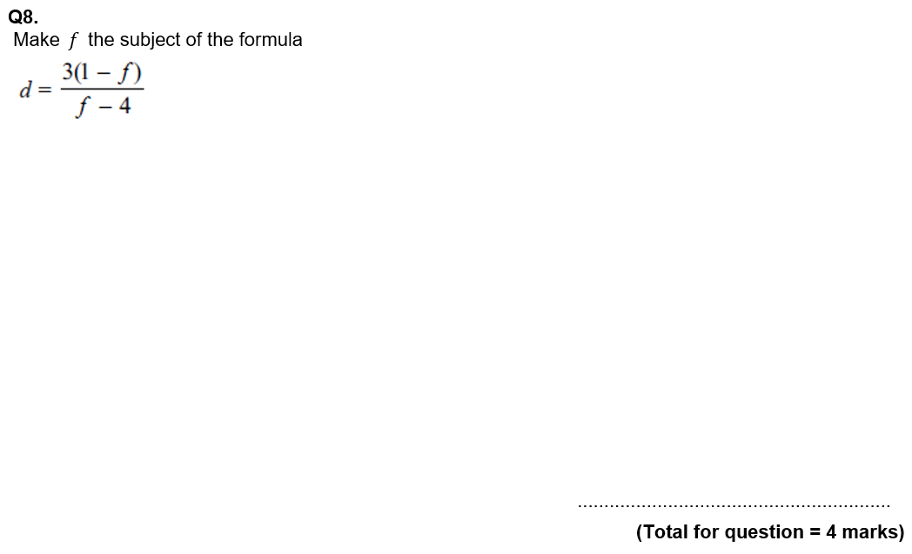

Slide 16
